Slide 1
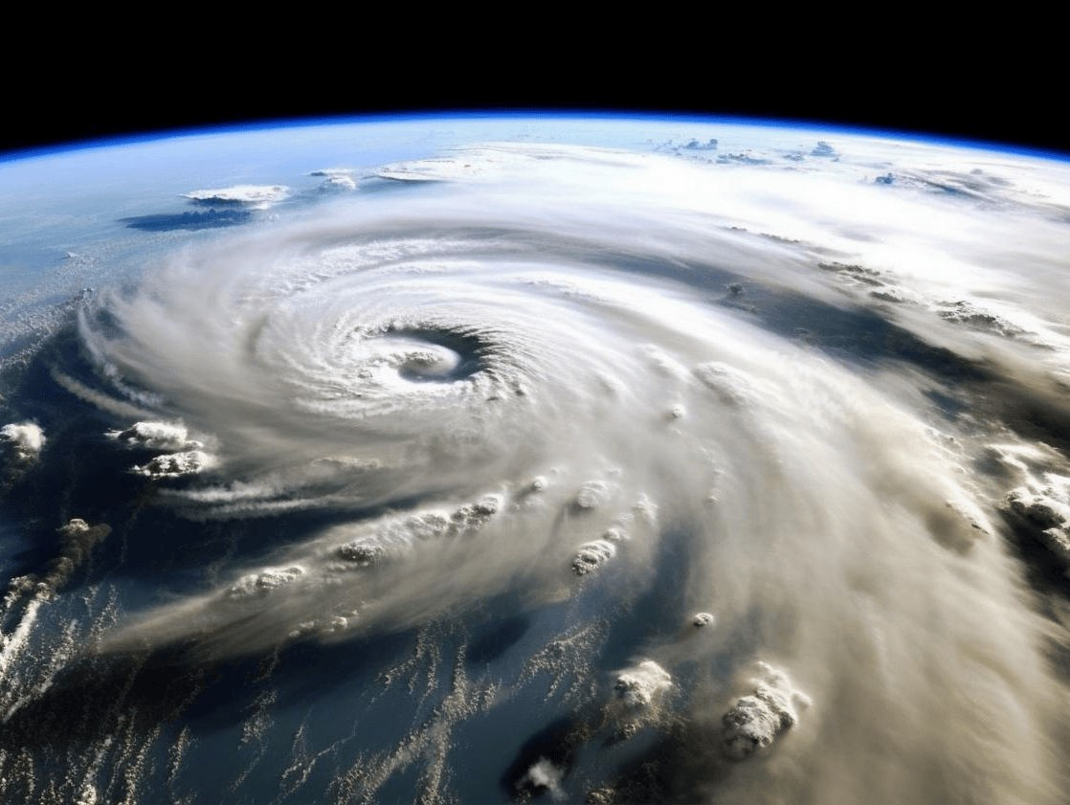
REQUIREMENT GATHERING FOR A MOBILE BASED DISASTER MANAGEMENT SYSTEM
GROUP 20

Slide 2
TABLE OF CONTENTS
-INTRODUCTION
-SURVEYS
-VICTIMS
-Problems Faced
-Types of Assistance Sought
-Features Considered Useful by Victims When Developing our Application
-Google Forms Summary For the Responses Gotten From Questions which were asked

Slide 3
-RESPONDENTS
-Respondents' Specialties in Case of a Disaster
-Features to Enhance in the System
-Challenges Faced in Accessing Affected Areas
-Challenges Faced in Communication
-Google Forms Summary For the Responses Gotten From Questions which were asked
-AUTHORITIES
-Features which they would Prioritize in the Disaster Management App
-Challenges Faced
-Google Forms Summary For the Responses Gotten From Questions which were asked
CONCLUSION

Slide 4

INTRODUCTION
Disaster management involves planning, coordination, & strategies to mitigate natural or man-made disasters. In today's digital age, a robust system is crucial for efficient response & recovery. It helps address emergencies, minimize loss, & enhance community resilience. Gathering comprehensive requirements aligning with authorities, victims, & respondents is essential for successful system development.

Slide 5
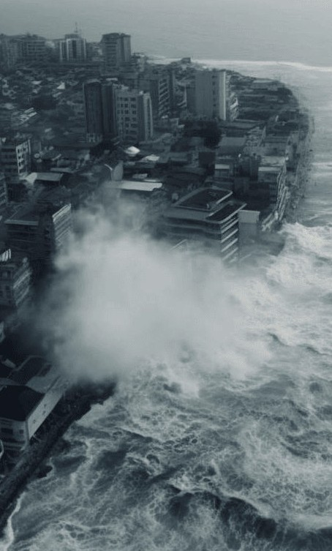
SURVEYS:
To ensure that our system should be as effective as possible we carried out surveys with the various stakeholders

Slide 6

Lack of Awareness Network Issues
Lack of Finance and Needs
1.VICTIMS
Problems Faced
Types of Assistance Sought
Medical Assistance Safety Tips Evacuation Routes Shelters

Slide 7

Features Considered Useful by Victims When Developing our Application
-Easy-to-Use Interface
-Oline Functionalities
-Quick Access to Emergency Contacts
-Real-Time Updates on Disaster Situations

Slide 8
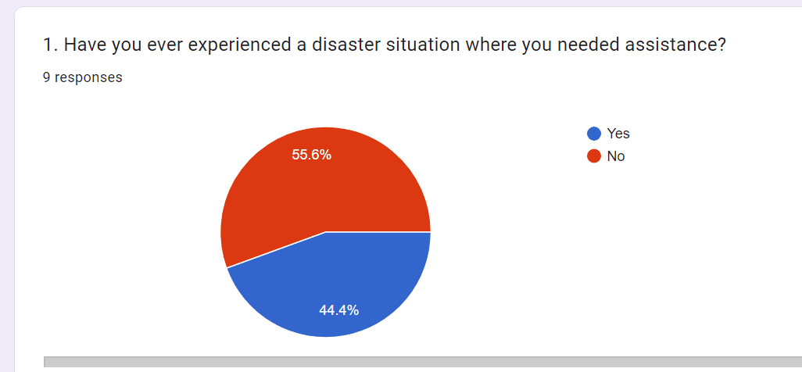
Google Forms Summary For the Responses Gotten From Questions which were asked
Add a body text

Slide 9
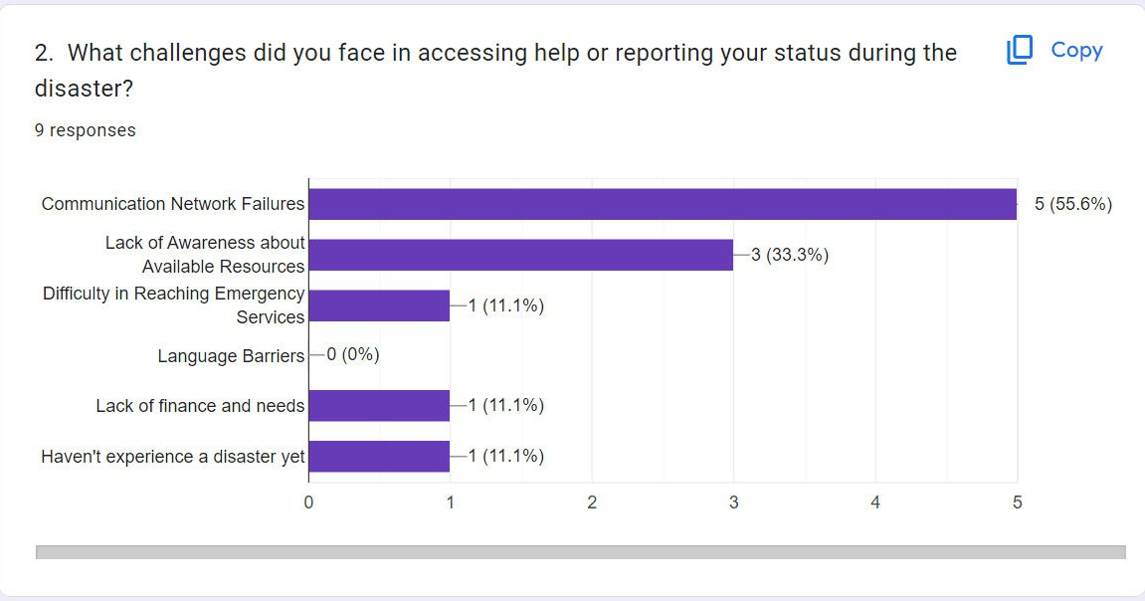

Slide 10
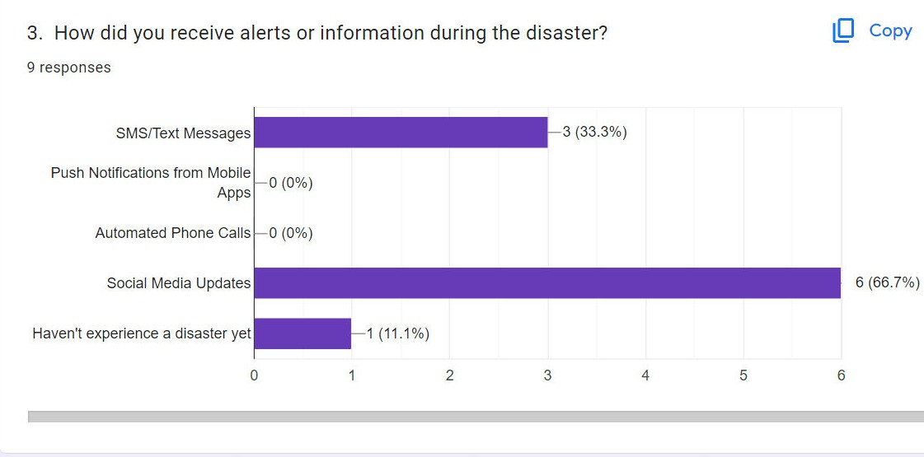

Slide 11
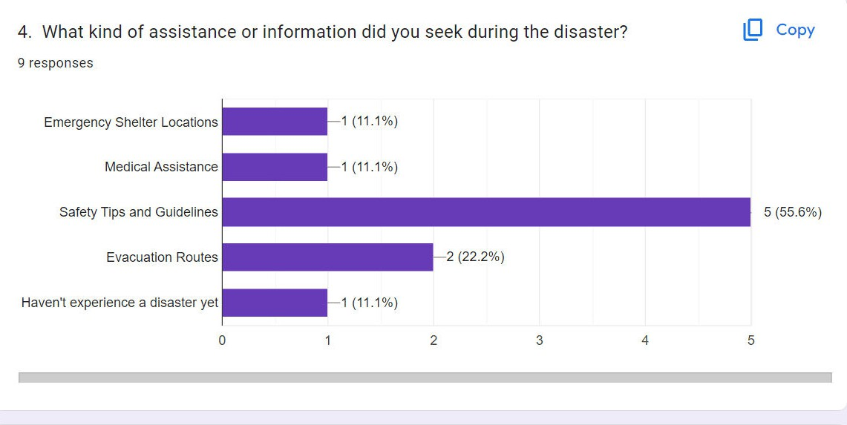

Slide 12
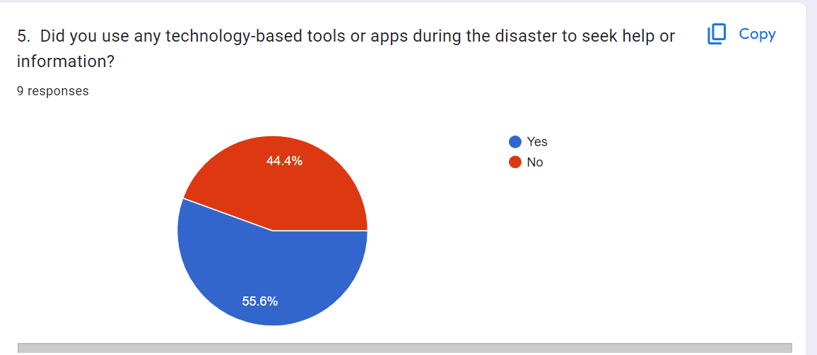

Slide 13
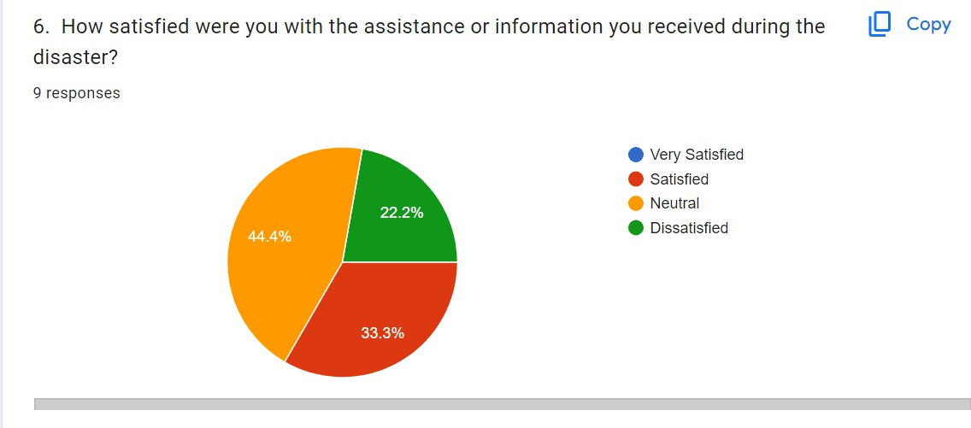

Slide 14
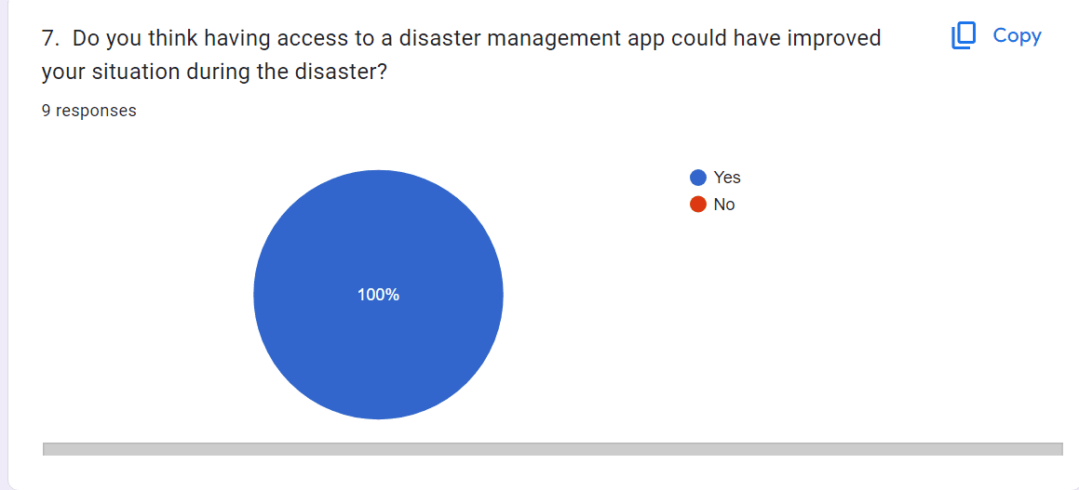

Slide 15
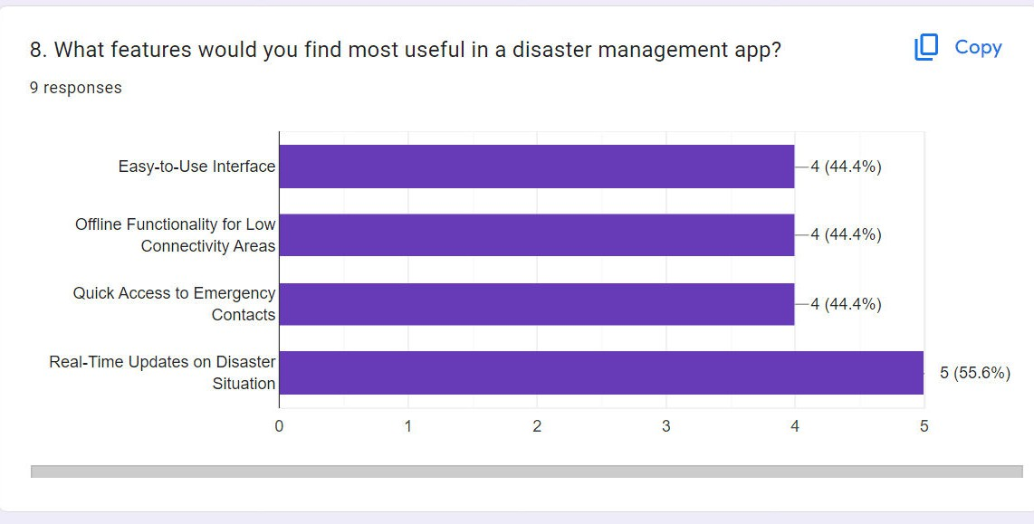

Slide 16
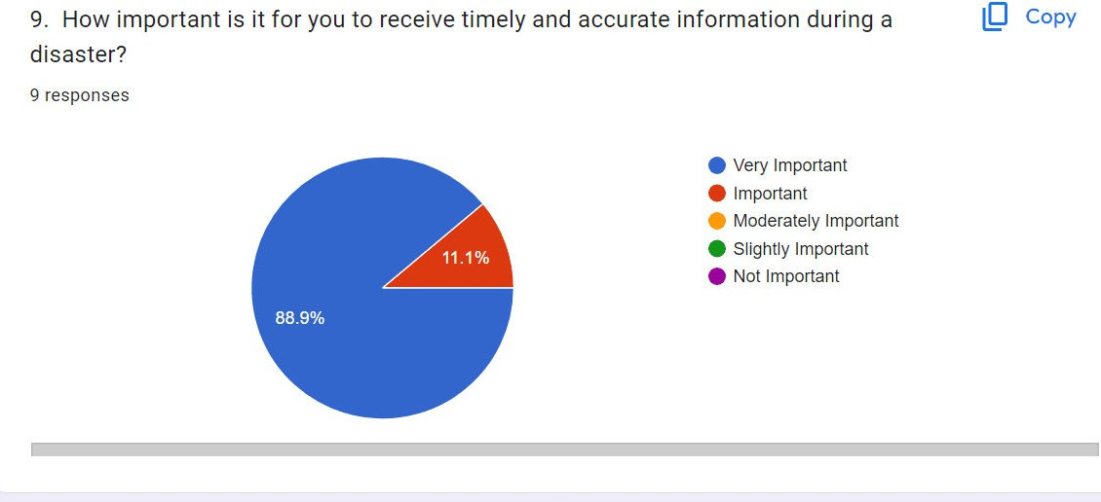

Slide 17
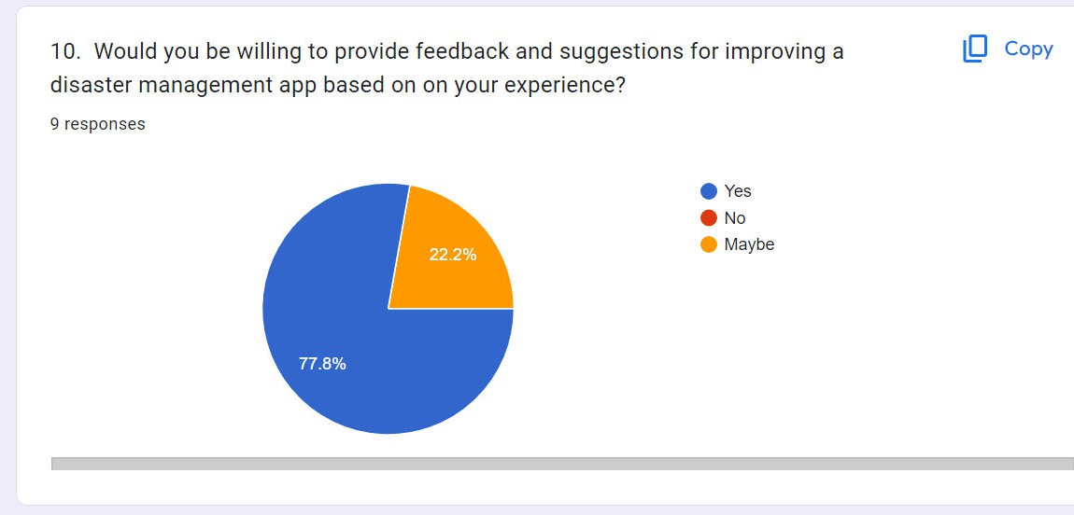

Slide 18
RESPONDENTS
This encompasses all personnels who Respond to disaster situations
Respondents' Specialties in Case of a Disaster
-Medical Training
-Technological Training
Features to Enhance in the System
-Real-Time Maps and Data Visualization
-Live Video Feeds
-Incident Reporting Tools
-Historical Data Analysis

Slide 19
Challenges Faced in Accessing Affected Areas
-Blocked Roads/Infrastructure Damage
-Lack of Accurate Information on Affected Areas
-Resource Limitations
Challenges Faced in Communication
-Lack of Communication Platforms
-Language Barrier

Slide 20
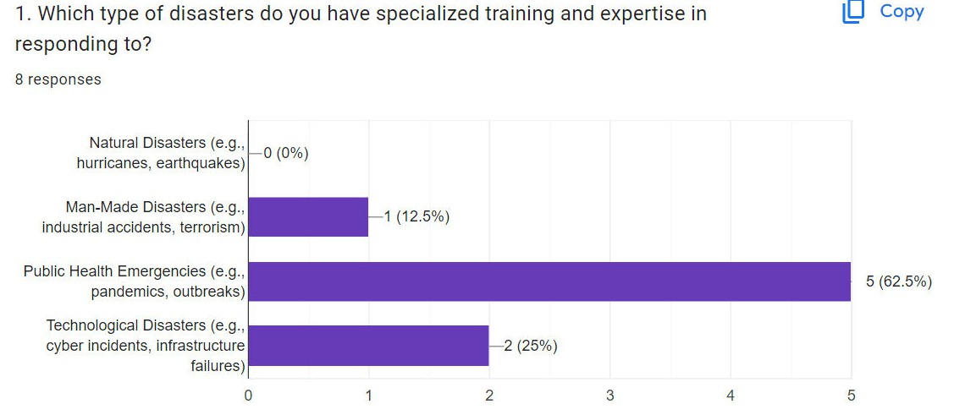
Google Forms Summary For the Responses Gotten From Questions which were asked

Slide 21
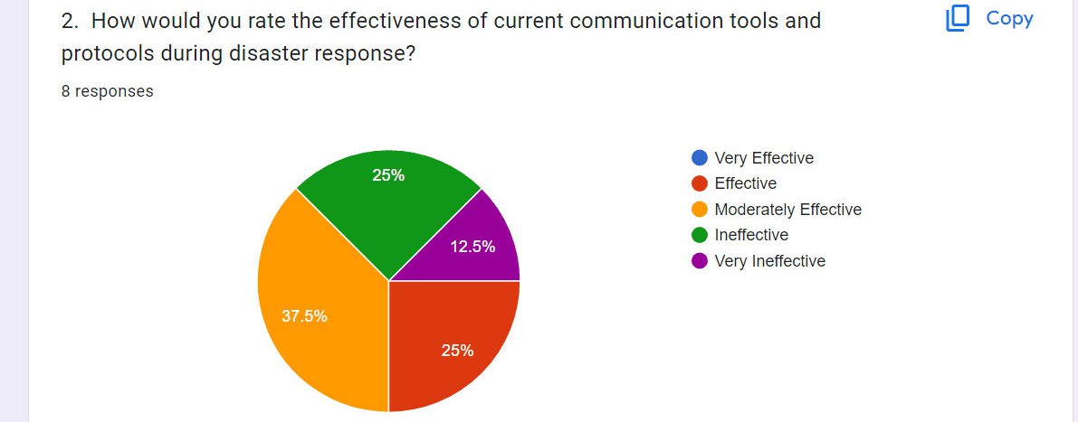
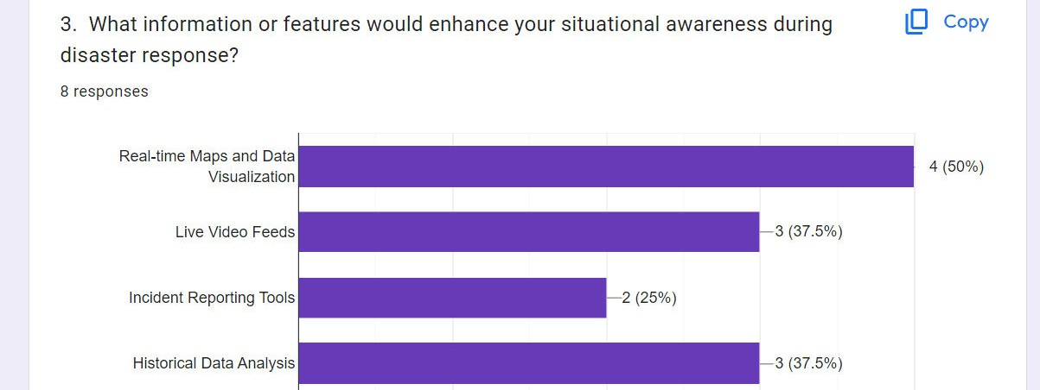

Slide 22
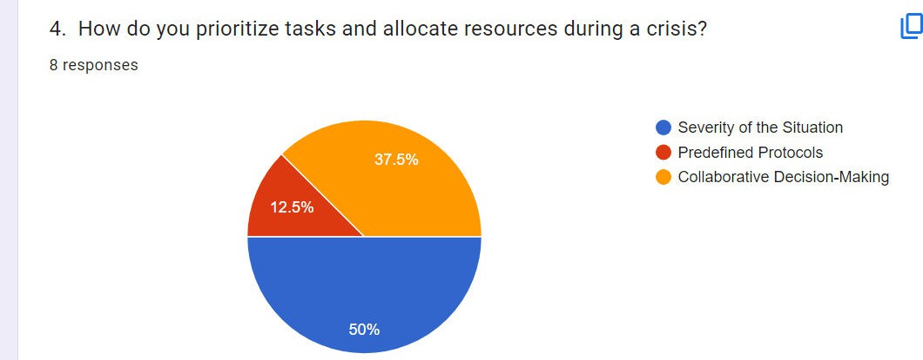

Slide 23
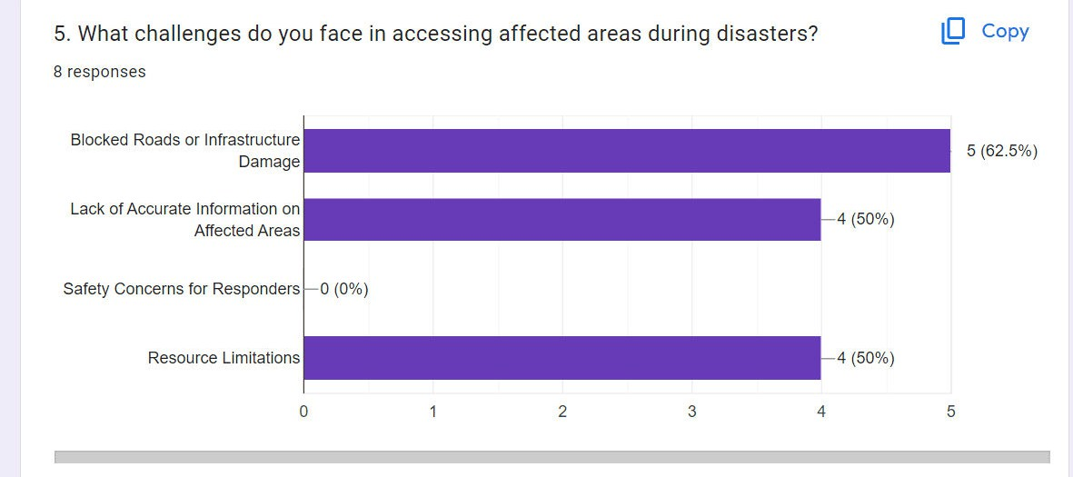

Slide 24
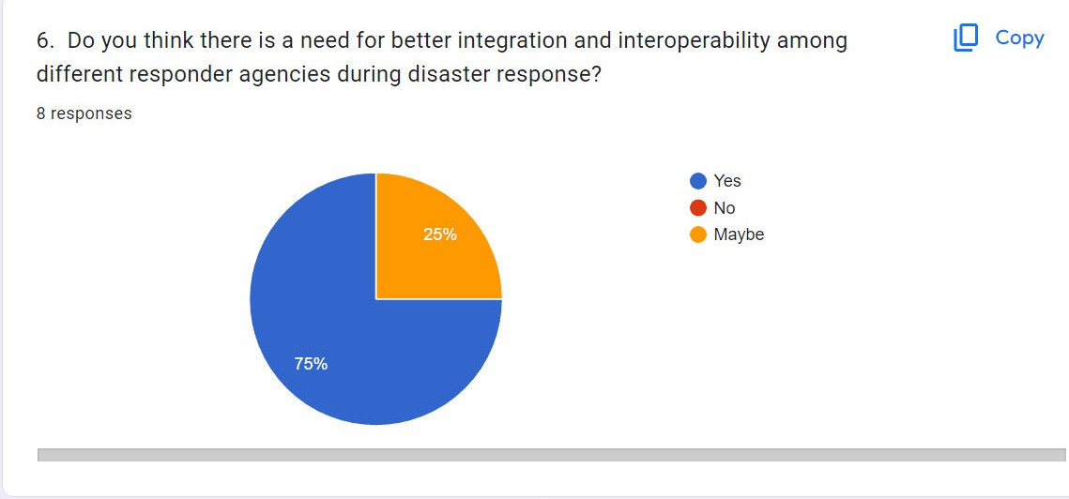

Slide 25
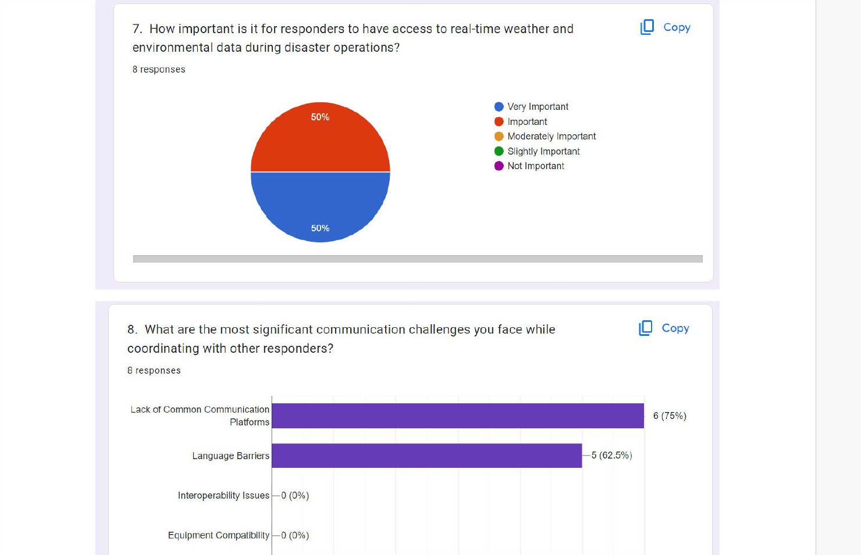

Slide 26
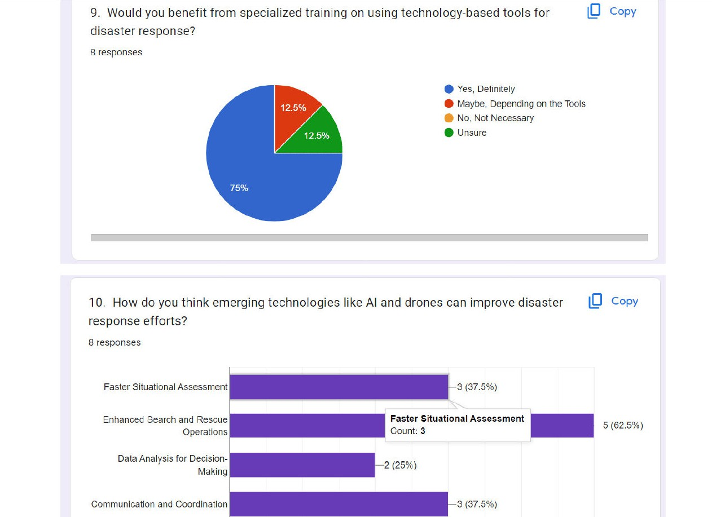

Slide 27


AUTHORITIES
In our disaster management system, several authorities and organizations play essential roles in coordinating and implementing emergency response efforts. The speciﬁc authorities may vary depending on the country or region, but some of the authorities in our case include
The Government
Medical Organizations: e.g World Health Organization

Slide 28
Features which they would Prioritize in the Disaster Management App
-Real-Time Data Analytics:
Robust real-time data analytics capabilities
-Emergency Alert System: Creating the ability to send timely and targeted alerts, notiﬁcations, and warnings to the affected population
-Resource Allocation and Tracking
-Communication Methods
Challenges Faced:
The main issue talked about by authorities was Network Issues

Slide 29
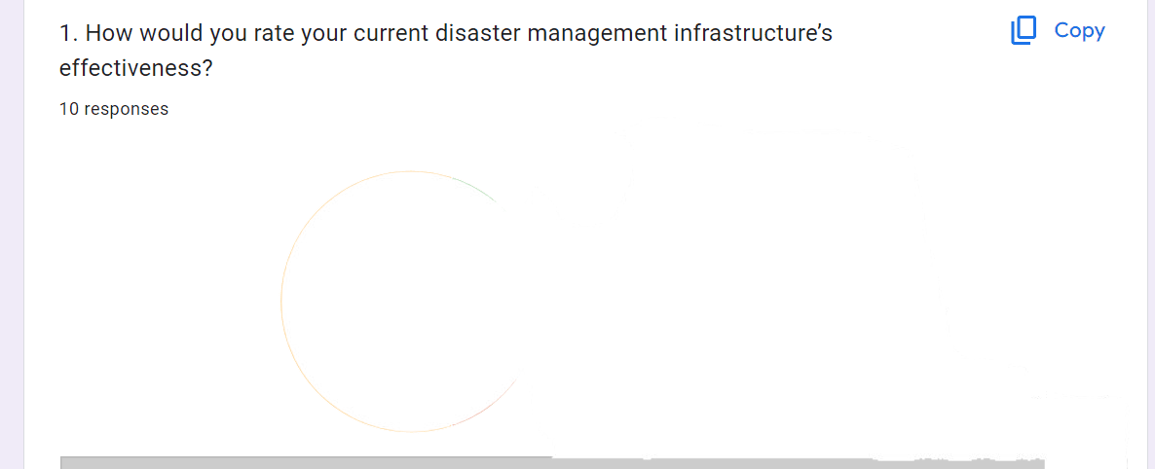
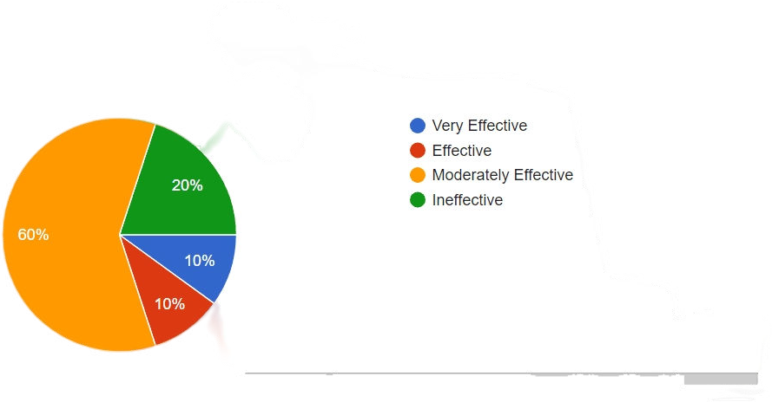
Google Forms Summary For the Responses Gotten From Questions which were asked

Slide 30
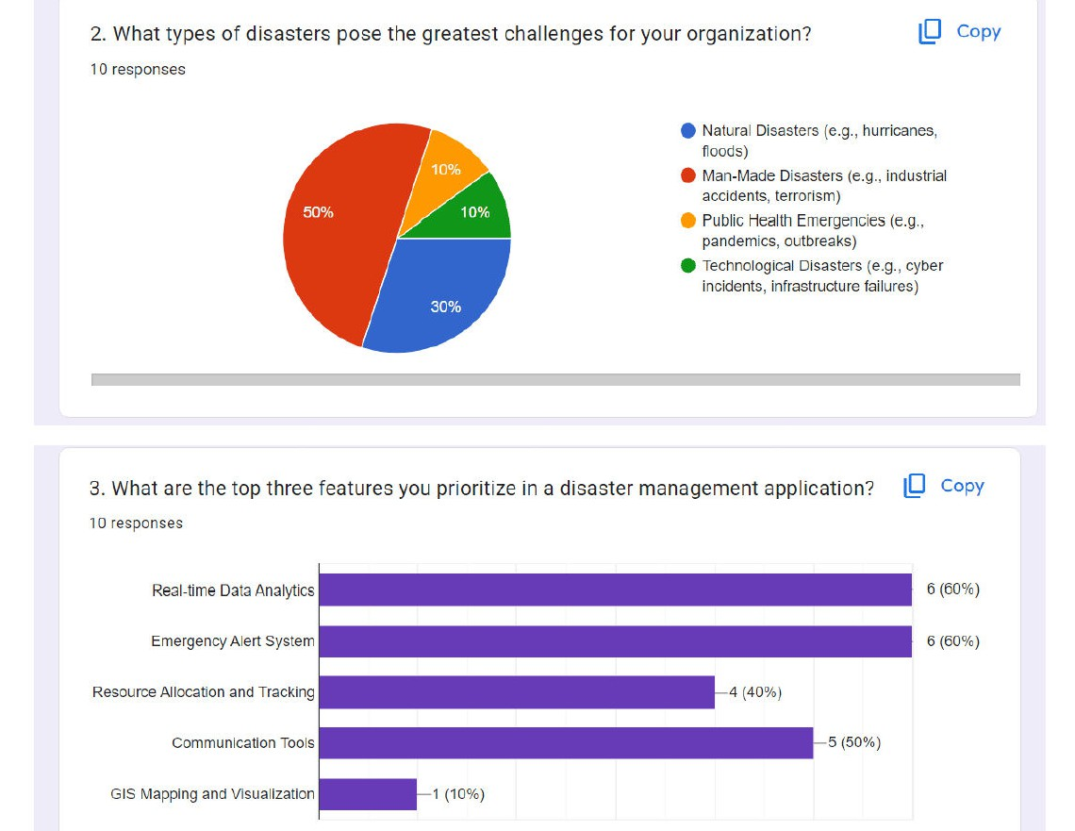

Slide 31
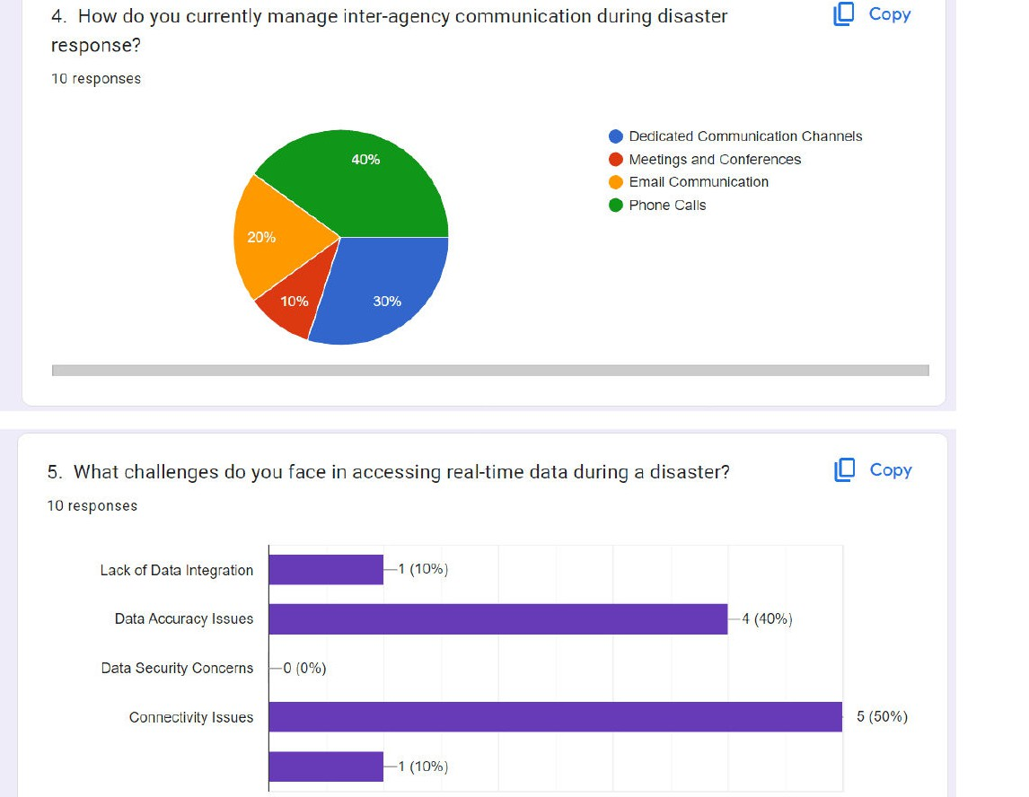

Slide 32
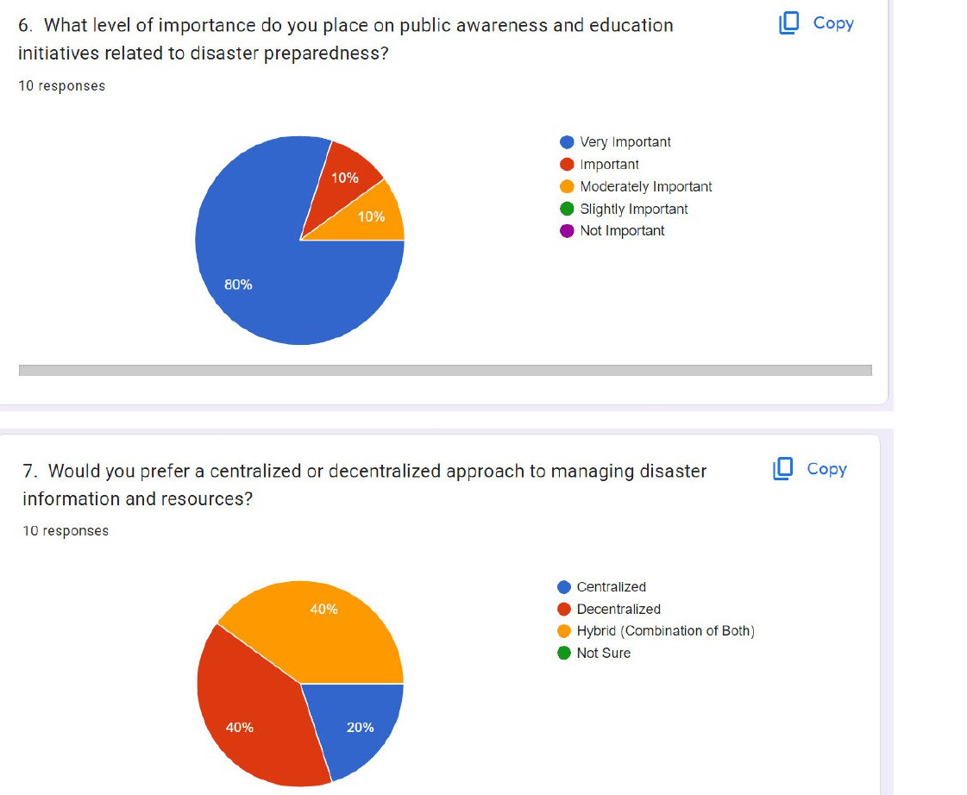

Slide 33
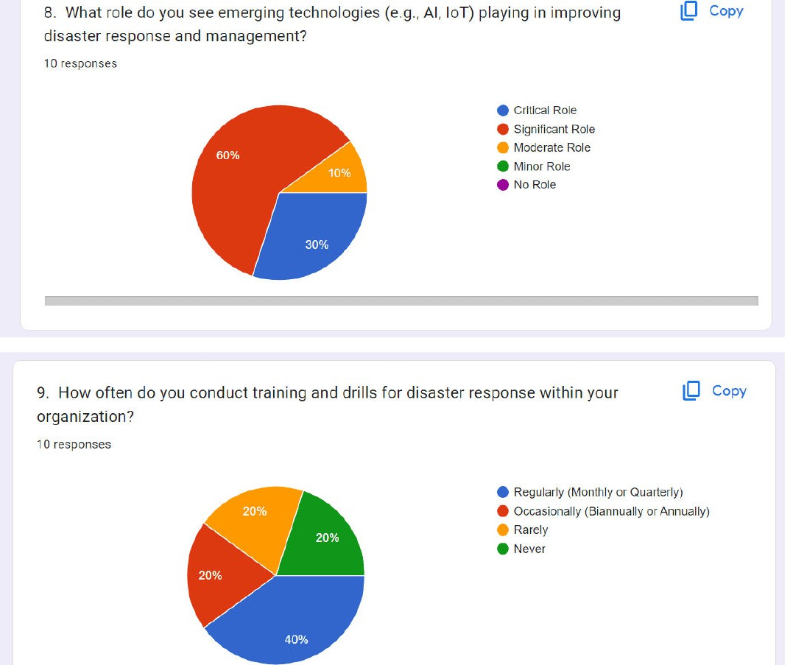

Slide 34
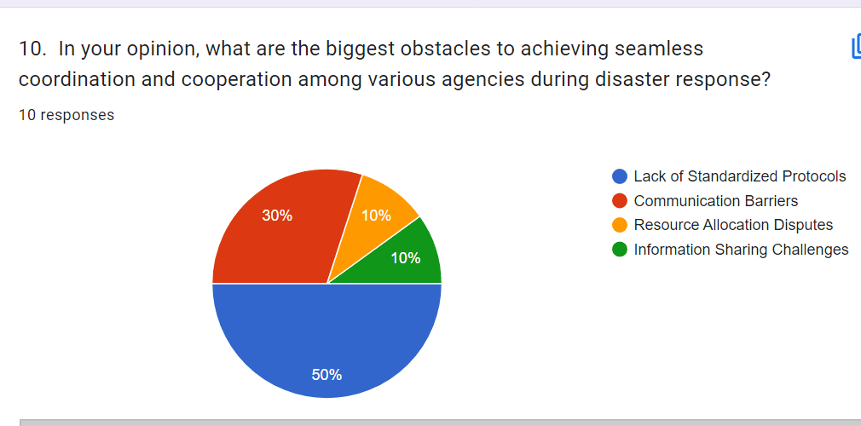

Slide 35
Conclusion
Developing a disaster management app with prioritized features is crucial.
It enhances response efforts by enabling efficient communication, coordination, and resource allocation.
Features like real-time alerts, location-based services, and incident reporting improve situational awareness and aid decision-making for authorities, victims, and respondents. Overcoming challenges like network connectivity and privacy concerns is essential for widespread adoption and effective disaster response.

Slide 36
THANK YOU

